Slide 1

Course No: URP 4000
Course Title: Project/Thesis
Air Pollution Removal by Urban Trees in Khulna City
Thesis Supervisor
Tusar Kanti Roy
Assistant Professor, Department of Urban and Regional Planning.
Examiner
Palash Chandra Das
Lecturer, Department of Urban and Regional Planning.
Submitted by:
K.M. Iqbal (1217031)
Md. Zayedur Rahman (1217054)
Sunzid Hassan (1217062)
Department of Urban and Regional Planning
Khulna University of Engineering & Technology

Slide 2
Content of this Presentation
Introduction
UFORE-D Dry Deposition Model
Case Study
Air Pollution Discussion
Significance of Urban Trees in Urban Development Thinking
Study Area
Methodology
Data Analysis
Findings
Recommendations
Further Scope
Limitations
Conclusion

Slide 3
Introduction
Pure air is vital for survival of life, but increasing air pollution causes various damage.
Tree leaf absorbs different pollution of air.
Objectives
To analyze current air pollution situation in Khulna city.
To measure air pollution removal by urban trees in Khulna city.
To provide strategies for air pollution control for Khulna city
Low pollution level in air is necessary for good quality urban life.
Thus it is necessary to measure effectiveness of tree as a measure to improve air quality.

Slide 4
UFORE-D Dry Deposition Model
Urban Forest Effects Dry Deposition (UFORE-D) model is used to assess air pollution removal by trees.
This model is used in numerous scholarly article
This model is used to assess pollution removal in widely used platform for tree service determination, i-Tree Eco.
Used to calculated removal of:
NO₂
SO₂
CO
O₃
PM10

Slide 5
Case Study
Air pollution removal by trees in public green spaces in Strasbourg city, France:
The study integrates i-Tree Eco model in order to estimate air pollution removal by urban trees for the first time in a French city.
It shows public trees of city reduces 88 tons of pollution in a year. 1 ton CO, 14 ton NO₂, 56 ton O₃, 12 ton PM₁₀, 5 ton PM_{2.5}.
Tree removed about 6.60% PM₁₀, but reduces only 0.03% of CO, 1.50% of PM_{2.5}, 0.50% of SO₂.
The study concludes that urban tree is significant element to reduce air pollution, but not the only solution to the problem.
[Source: Selmi, et al., 2016.]

Slide 6
Air Pollutants Discussion
Air Quality Standard
35ppm (hourly avg.) for CO, 0.053ppm (annual avg.) for NOx, 50 μg/m³ (annual avg.) for PM10, 0.12ppm (hourly avg.) for O₃, 0.03 ppm (annual avg.) for for SO₂
Major sources of air pollution
Motor vehicle, Power plant, Brick kiln, industries, construction works etc.
Effects of air pollution
Direct physical damage including respiratory disease, premature death etc.
[Source: Department of Environment, 2017]

Slide 7
Tree as air pollution reduction measure
Limitations in air pollution prevention measure increases importance of pollution mitigation by tree.
Limitations in prevention measure
In Bangladesh, preventive measures lack success because of poor governance, lack of data and monitoring capacity.
Priority in industrialization
As a developing country, industries are often allowed to release pollution in order to keep production price low.
Lack of priority about pollution reduction in construction and industrial approach.
Important natural air pollution remover
Controllable approach
Unlike natural pollution reducer like rain or water body, trees can be controlled, increased.

Slide 8
Significance of Urban Trees in Urban Development Thinking
World Urban Campaign
WUC is a advocacy and partnership platform of UN-Habitat.
Green city is one of 6 thematic area of WUC, which seeks to achieve carbon efficient sustainable city.
Sustainable Development Goals
SDG 11 is the only goal dedicated to cities. The second indicator of 6th standard of goal 11 is to keep PM10 and PM2.5 within standard in air.
New Urban Agenda
Quito Papers and New Urban Agenda has area of commitment about increasing public parks, gardens etc. in urban area.
[Source: UN-Habitat 2012, United Nations, 2016]
Fig: Air Quality Performance based on SDG 11 (Data source: United Nations Statistics, 2017

Slide 9
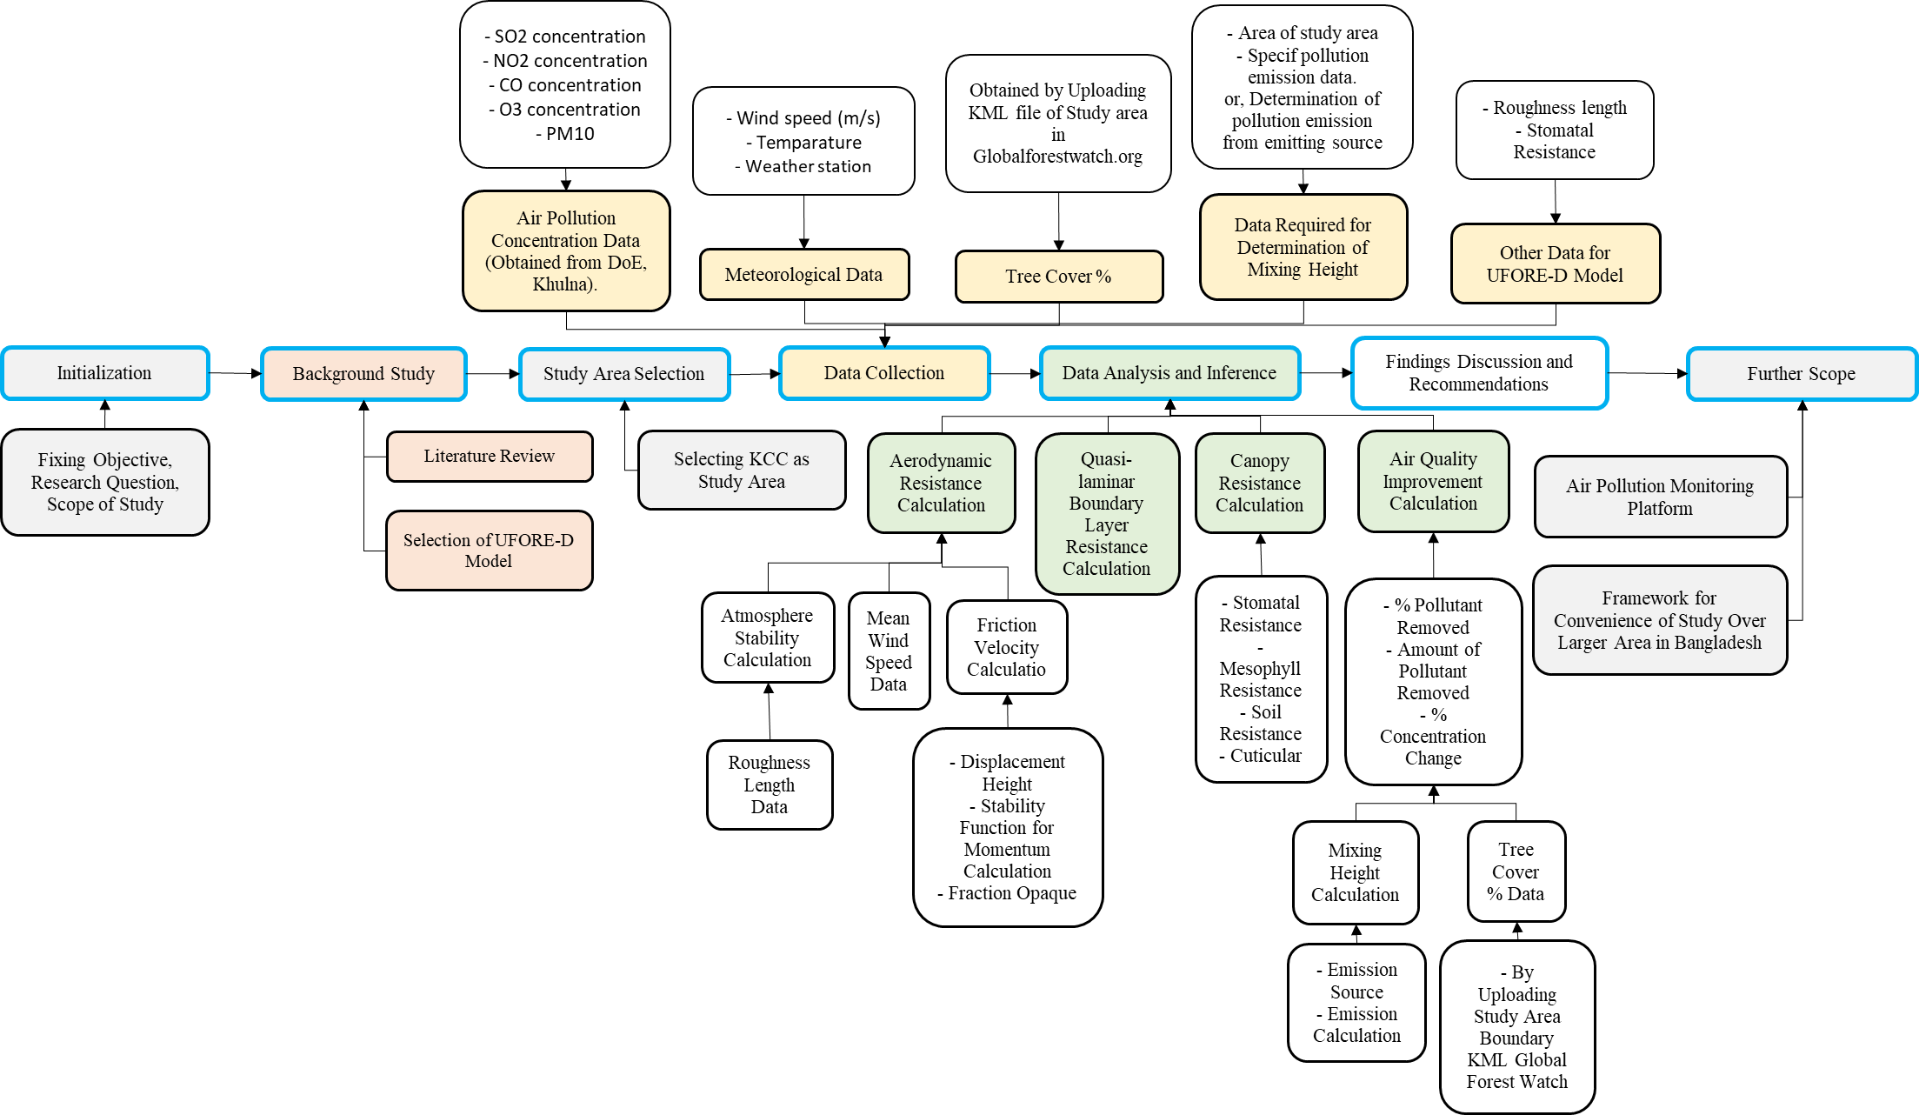
Methodology

Slide 10
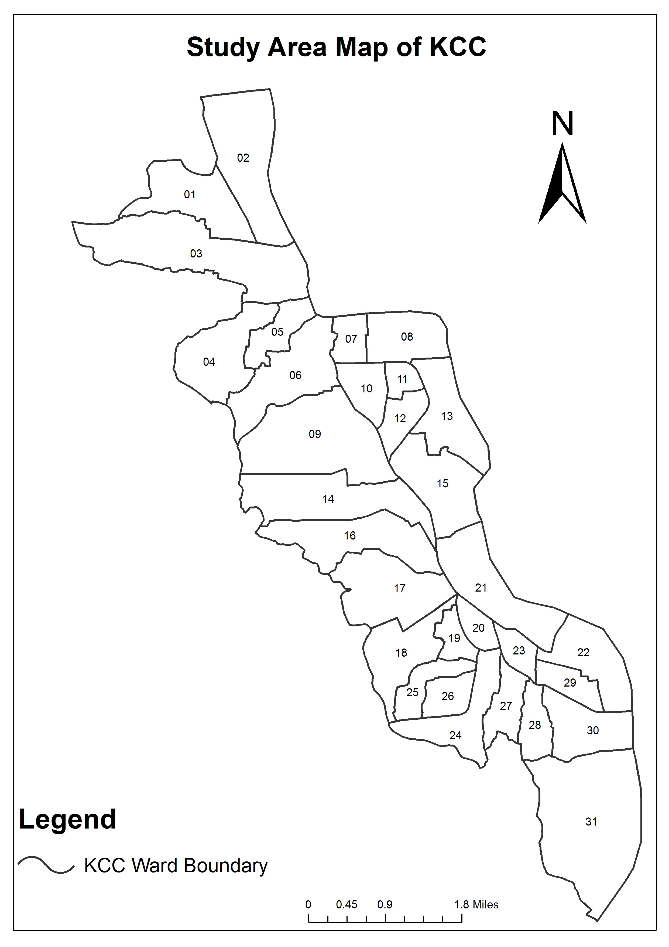
Study Area
The study area is Khulna City.
State of tree cover
Khulna has only 6.35% tree cover. That is, 288ha among 4534 ha.
Fig: Study Area Map

Slide 11
State of air pollution in Study Area
Fig: NO₂ concentration Level Compared to Standard [Data Source: DoE Khulna, 2017].
Fig: O₃ concentration Level Compared to Standard [Data Source: DoE Khulna, 2017].
Fig: SO₂ concentration Level Compared to Standard [Data Source: DoE Khulna, 2017].
Fig: CO concentration Level Compared to Standard [Data Source: DoE Khulna, 2017].

Slide 12
State of air pollution in Study Area
State of air pollution
Almost every air pollutants average level in air of Khulna city is under standard.
However, average concentration level of particulate matter is highest among different pollutants.
Fig: PM concentration Level Compared to Standard [Data Source: DoE Khulna, 2017].

Slide 13
Data Collection
Air pollution concentration data
Concentration data of SO₂, NO₂, CO, O₃, PM10 was obtained from DoE (Department of Environment), Khulna. The data source is CAMS (Continuous Air Monitoring System, Funded by WB) project.
Meteorological data
Wind speed, temperature, weather station height.
Tree cover % data
Obtained by uploading KML file of study area in Global Forest Change websites dataset.
Data required for determination of mixing height
Area of study area, data required for determination of pollution emission
Other data required by model
Roughness length, stomatal resistance, Leaf Area Index

Slide 14
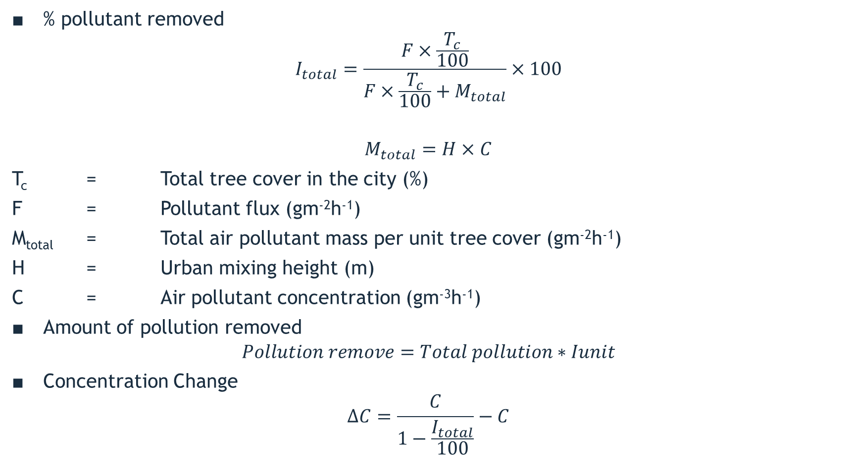
Data Analysis: Air Quality Improvement
% pollutant removed
$$I_{total}=\frac{F×\frac{T_{c}}{100}}{F×\frac{T_{c}}{100}+M_{total}}×100$$
$$M_{total}=H×C$$
T_{c} = Total tree cover in the city (%)
F = Pollutant flux (gm⁻²h⁻¹)
M_{total} = Total air pollutant mass per unit tree cover (gm⁻²h⁻¹)
H = Urban mixing height (m)
C = Air pollutant concentration (gm⁻³h⁻¹)
Amount of pollution removed
$$Pollution remove=Total pollution∗Iunit$$
Concentration Change
$$∆C=\frac{C}{1−\frac{I_{total}}{100}}−C$$

Slide 15
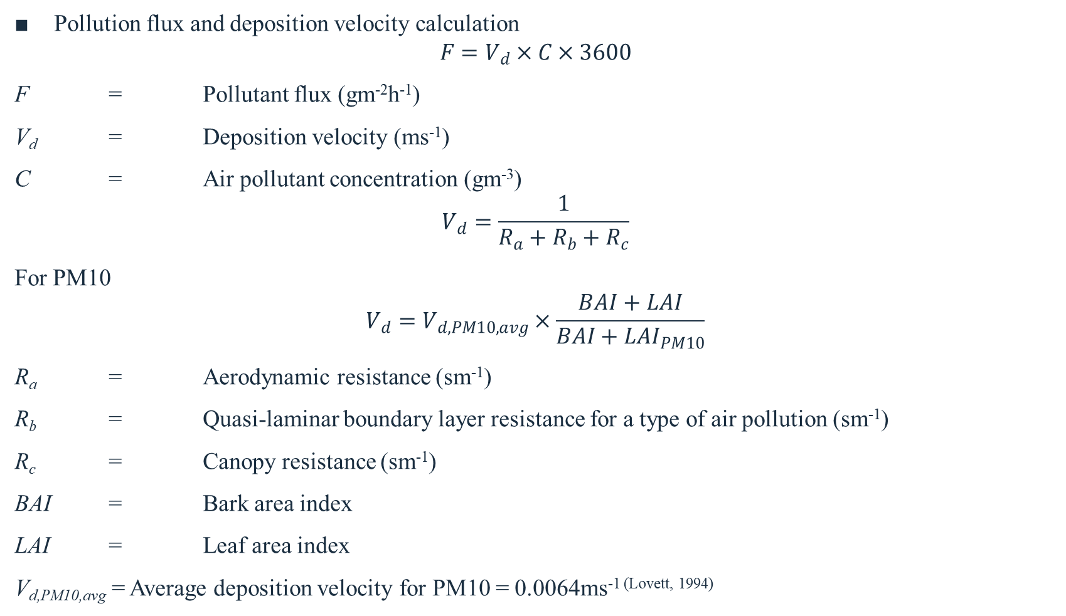
Data Analysis
Pollution flux and deposition velocity calculation
$$F=V_{d}×C×3600$$
F = Pollutant flux (gm⁻²h⁻¹)
V_{d} = Deposition velocity (ms⁻¹)
C = Air pollutant concentration (gm⁻³)
$$V_{d}=\frac{1}{R_{a}+R_{b}+R_{c}}$$
For PM10
$$V_{d}=V_{d,PM10,avg}×\frac{BAI+LAI}{BAI+{LAI}_{PM10}}$$
R_{a} = Aerodynamic resistance (sm⁻¹)
R_{b} = Quasi-laminar boundary layer resistance for a type of air pollution (sm⁻¹)
R_{c} = Canopy resistance (sm⁻¹)
BAI = Bark area index
LAI = Leaf area index
V_{d,PM10,avg} = Average deposition velocity for PM10 = 0.0064ms^{-1 (Lovett, 1994)}

Slide 16

Data Analysis: Calculation of Ra
Aerodynamic Resistance Calculation as (Killus, et al., 1984)
$$R_{a}=\frac{u(z)}{u_{∗}^{2}}$$
u(z) = Mean wind speed at height z (ms⁻¹)
u* = Friction velocity (ms⁻¹)
Pasquill = A: $\frac{1}{L}=−0.0875∗z_{0}^{−0.1029}$
L = Monin-Obuhkov stability length
z₀ = Roughness length

Slide 17
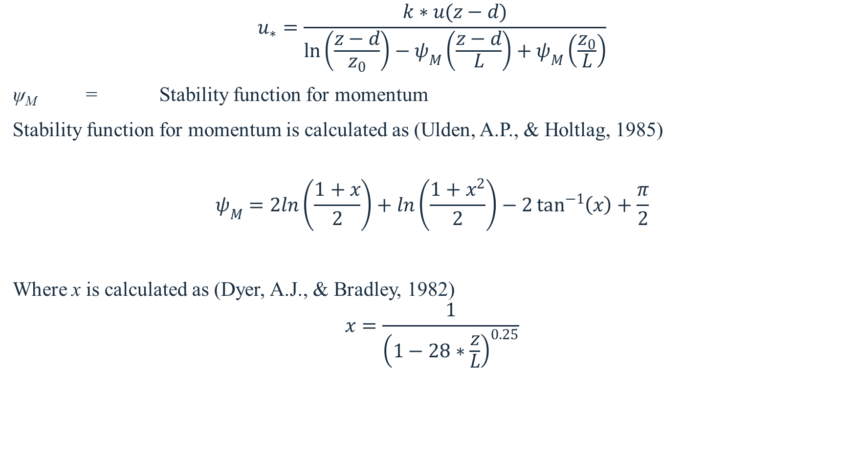
Data Analysis : Calculation of Ra
$$u_{∗}=\frac{k∗u(z−d)}{\ln\left(\frac{z−d}{z_{0}}\right)−ψ_{M}\left(\frac{z−d}{L}\right)+ψ_{M}\left(\frac{z_{0}}{L}\right)}$$
ψ_{M} = Stability function for momentum
Stability function for momentum is calculated as (Ulden, A.P., & Holtlag, 1985)
$$ψ_{M}=2ln\left(\frac{1+x}{2}\right)+ln\left(\frac{1+x^{2}}{2}\right)−2\tan^{−1}\left(x\right)+\frac{π}{2}$$
Where x is calculated as (Dyer, A.J., & Bradley, 1982)
$$x=\frac{1}{{\left(1−28∗\frac{z}{L}\right)}^{0.25}}$$

Slide 18

Data Analysis
Quasi-laminar boundary layer resistance (R_{b}) is calculated as (Pederson, et al., 1995):
$$R_{b}=2{\left(Sc\right)}^{\frac{2}{3}}{\left(Pr\right)}^{−\frac{2}{3}}{\left(ku_{∗}\right)}^{−1}$$
Sc = Schmidt number
Pr = Prandtl number

Slide 19
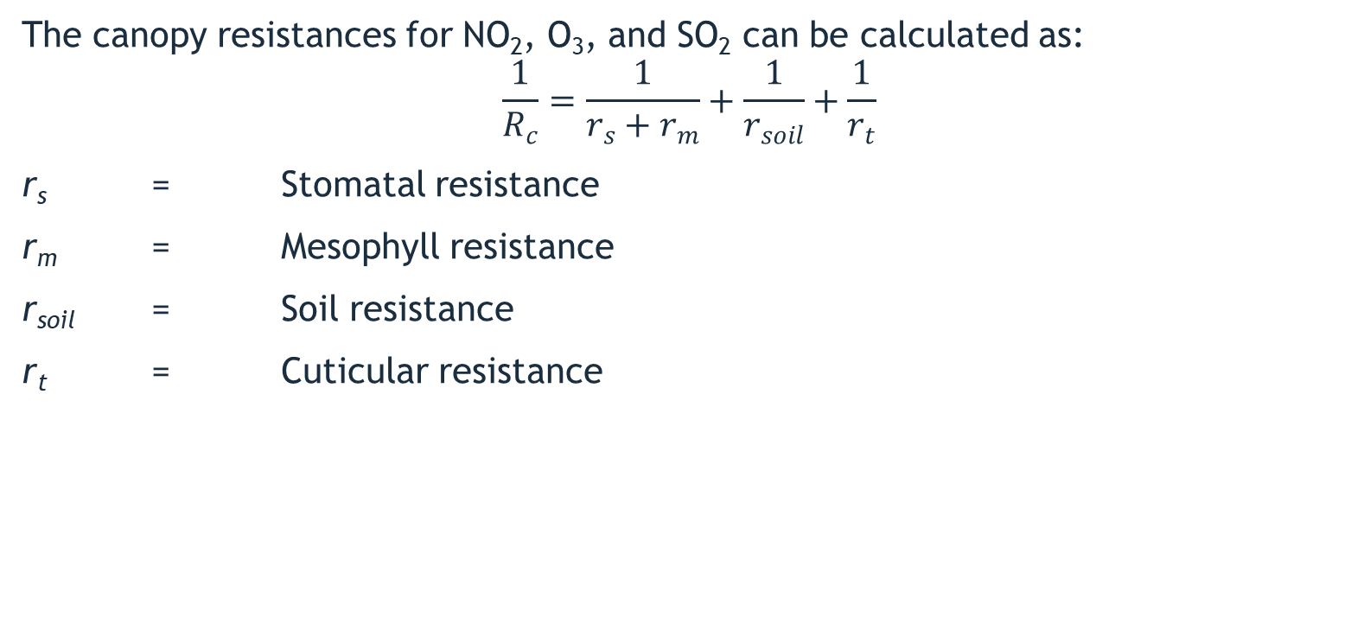
Data Analysis
The canopy resistances for NO₂, O₃, and SO₂ can be calculated as:
$$\frac{1}{R_{c}}=\frac{1}{r_{s}+r_{m}}+\frac{1}{r_{soil}}+\frac{1}{r_{t}}$$
r_{s} = Stomatal resistance
r_{m} = Mesophyll resistance
r_{soil} = Soil resistance
r_{t} = Cuticular resistance

Slide 20
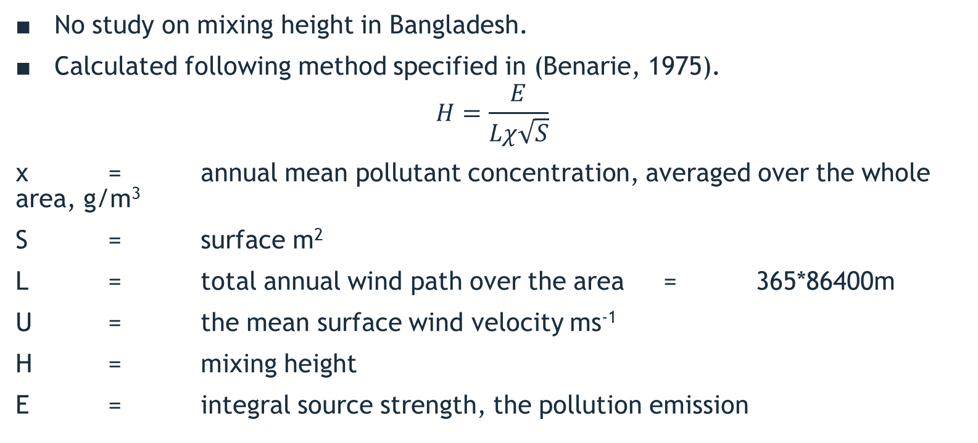
Data Analysis
No study on mixing height in Bangladesh.
Calculated following method specified in (Benarie, 1975).
$$H=\frac{E}{Lχ\sqrt{S}}$$
χ = annual mean pollutant concentration, averaged over the whole area, g/m³
S = surface m²
L = total annual wind path over the area = 365*86400m
U = the mean surface wind velocity ms⁻¹
H = mixing height
E = integral source strength, the pollution emission

Slide 21
Data Analysis
Tree cover data obtained from Globalforestwatch.org
High reliability
Data generated with collaboration of Matt Hansen, Google Earth, and NASA
Used in numerous scholarly articles, used by UN, in Google Earth Platform
Uploaded KML file of study area
Results: tree cover only 6.35% in Khulna

Slide 22
Findings
In Jan-Jul of 2015 | NO₂ | O₃ | SO₂ | CO | PM10
Pollutant Removed (%) | 0.15 | 0.20 | 0.21 | 0.0008 | 0.22
Concentration Change (ppm) | 0.00001 | 0.00002 | 0.00003 | 0.00004 | 0.1 (μg/m³)
Amount Removed (tons) | 2.16 | 2.24 | 4.17 | 0.56 | 14.35
Monetary Value (USD) | $25703.22 | $26605.86 | $12139.00 | $951.19 | $113,953.89

Slide 23
Recommendations
Higher need for increasing ward wise tree cover. Tree cover should be increased in ward no 07, 11, 20, 21, 23, 27 and 29.
Prevention measure instead of mitigation measure to reduce air pollution
Include Strategy in Khulna Master Plan
Fitting DPF(Diesel Particulate Filter) in vehicles with diesel engine
Use of green brick kiln in Khulna
Ban two stroke vehicles in Khulna
Others: Better pollution data collection, increasing capacity of DoE Khulna so that they can execute air pollution reduction measures, integrating development authorities and environmental management authorities to control air pollution etc.

Slide 24
Further Scope
Framework for Convenience of Study over Larger Area in Bangladesh
This study introduces methodology that addresses the data limitations of Bangladesh, and provides solution to conduct the study. Thus methodology of this study is applicable all over the country.
Further more, a calculation model is prepared under this study that can enable further study in other parts of Bangladesh with convenience.
Air Pollution Monitoring Platform
It is possible to make a web based monitoring platform that takes required data, conduct analysis and alert authority is pollution after removal by tree is higher than standard.

Slide 25
Limitations
Requirement of various and continued meteorological data for an extended period of time. But data of larger period is of not continuous in Bangladesh.
Validation Problem: There is only one meteorological data source in Bangladesh. It’s the CAMS (Continuous Air Monitoring System, funded by World Bank). The data source is legitimate, but validation by comparison is not possible in Bangladesh.
Absence of similar study in Bangladesh: Thus it wasn’t possible to compare results.
No scholarly article was found about air pollution removal by trees in Bangladesh.
Dr. Md. Ashaduzzaman, Associate Professor, Forestry and Wood Technology Discipline, Khulna University told authors of this study that there is no similar study conducted in Bangladesh.

Slide 26
Conclusion
Modeling air pollution removal reveals the magnitude of tree effects on improving urban air quality.
The effects of trees in Khulna are relatively small with less than one percent air quality improvement for different pollutants, but depending upon the pollutant, this small percent have substantial health impacts for local residents (Nowak, Hirabayashi, Bodine, & Greenfield, 2014).
The removal of 23.48 tons of pollution reduced in 7 months of 2015 by trees can improve air quality and offset local emissions.
Urban planners need to consider the impact of urban tree and green spaces on local air quality to create better and more informed plans that ensure air purification and sustain human health in cities.

Slide 27
Acknowledgement
We’ll like to pay our deep gratitude to the Supervisor of this study, Tusar Kanti Roy, Assistant Professor, DURP KUET for his continuous support, encouragement for this work.
We’ll like to thank our Examiner Palash Chandra Das, Lecturer, DURP KUET.
We’re thankful to Satoshi Hirabayashi, GIS/Environmental Modeler, The Davey Institute, c/o US Forest Service for assisting us with methodology related problems of this study.
Md. Kamruzzaman, Senior Chemist, DoE Khulna has helped us with data and suggestion from the very beginning of this study.
Dr. Md. Ashaduzzaman, Associate Professor, Forestry and Wood Technology Discipline, Khulna University has provided with suggestions for our study.
We’ll like to thank the honorable faculty members of DURP.
Lastly we’ll like to thank all the people who helped us with our study.

Slide 28
References
Department of Environment of Government of Bangladesh. (2012). Air Pollution Reduction Strategy for Bangladesh. Dhaka: Government of Bangladesh.
Selmi, W., Weber, C., Rivière, E., Blond, N., Mehdi, L., & Nowak, D. (2016, April 28). Air pollution removal by trees in public green spaces in Strasbourg City, France. Urban Forestry & Urban Greening, 192-201.
UN-Habitat. (2012). About: World Urban Campaign. Retrieved April 16, 2017, from http://www.worldurbancampaign.org/about
United Nations. (2016). Resolution adopted by the General Assembly. United Nations.

Slide 29
Thank you

